Slide 1

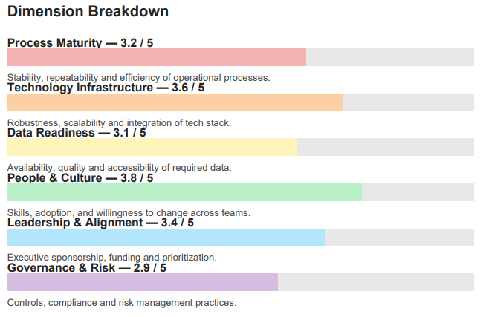
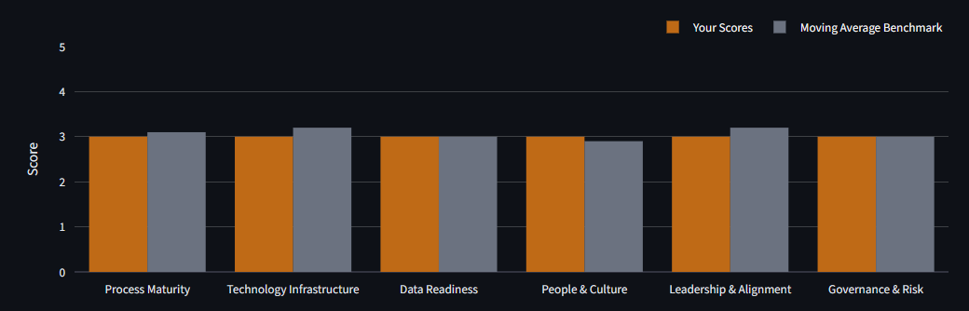
AI-Enabled Readiness Assessment^{[1]}
XYZ Company
AI-Enabled Readiness Assessment
XYZ Company
Overall Readiness
18/30
Readiness %:
60%
Reliable
Indicates:
“Consistent &
Dependable”
These dimension bar colors should match the app dimension bar colors
64%
72%
Executive Summary:
62%
Your current processes are showing good traction for implementing AI solutions and testing using pilot projects. Still, some areas of improvement include…
76%
68%
Label should match Readiness level color
58%
Industry Benchmark Comparison:
Your Score:
18.0/39
Benchmark ScoreL
18.4/3
Difference
[up/down]
Actual Radar Chart
Here
Placeholder for Dimension Comparison Char (White background, dark text, numerical values above bars)
[1] Scores represent a subjective indication of AI process implementation preparedness and is not a substitute for rigorous investigation
www.tlogic.consulting
T-Logic Consulting Pvt. Ltd.
1
www.tlogic.consulting
T-Logic Consulting Pvt. Ltd.
2

Slide 2
AI-Enabled Readiness Assessment
XYZ Company
Recommended Actions:
The following recommendations are based on the scores derived from the T-Logic AI ReadinessTM app:
Process Maturity…
  Asdfas
Use AI to develop recommendations on any dimension score less than 3.0. Don’t make it looked like a canned response.
Contact us at info@tlogic.consulting for any assistance!
www.tlogic.consulting
T-Logic Consulting Pvt. Ltd.
3

